Slide 1
AI & Machine Learning
CA2 PART A: Time Series
By: Yek Yi Wei (p2107631)
Diploma in Applied AI & Analytics

Slide 2
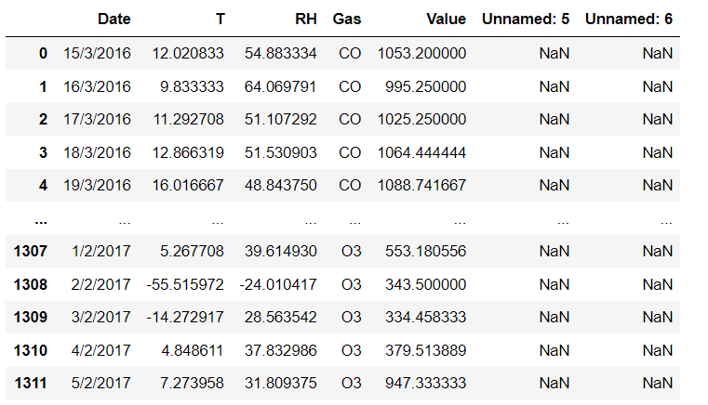
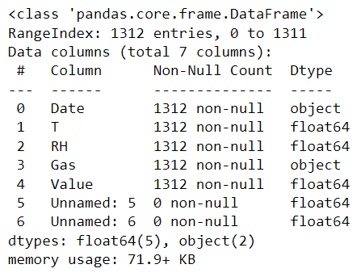
PART A: TIME SERIES Air Pollution Forecasting
Default dataset
Daily Data 2016-3-15 to 2017-02-05

Slide 3
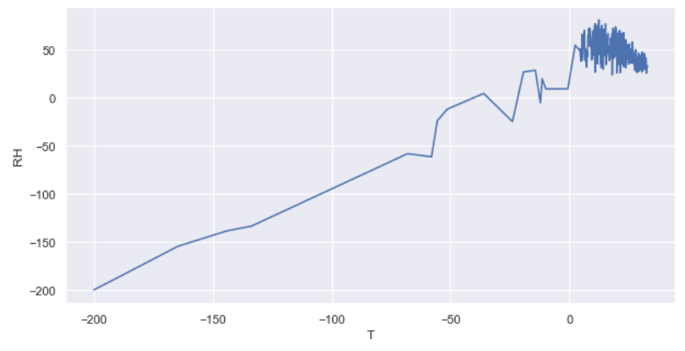
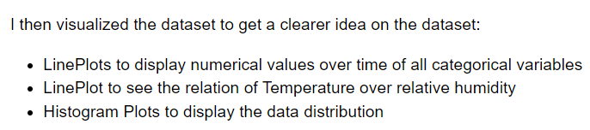
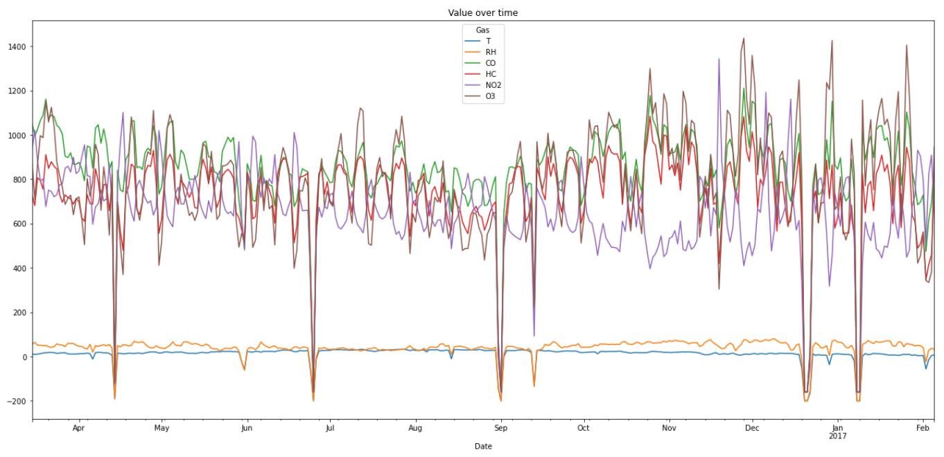
EDA: Exploratory Data Analysis
Data over time

Slide 4
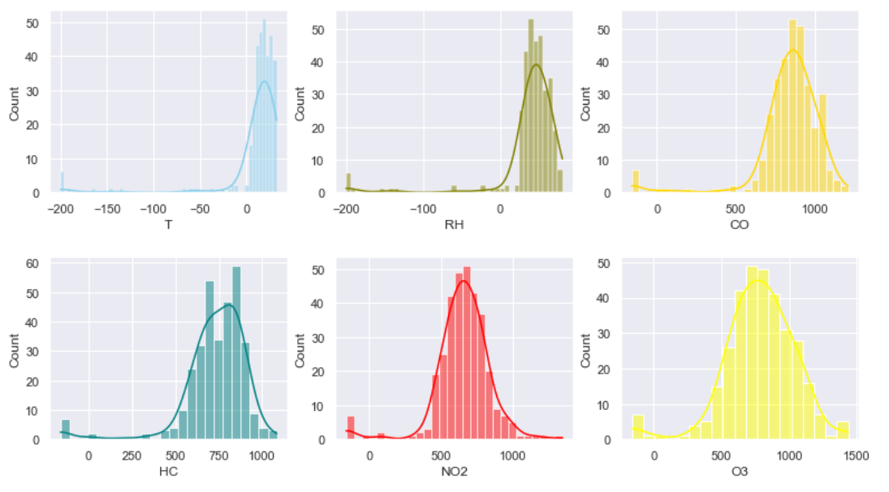
EDA: Exploratory Data Analysis
All the data fields are approximately normal distributed (Bell shape)

Slide 5
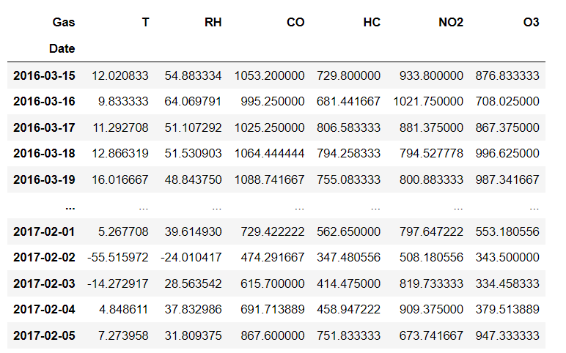
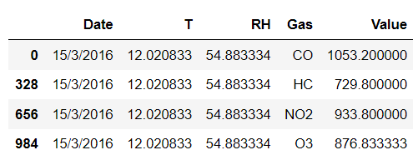
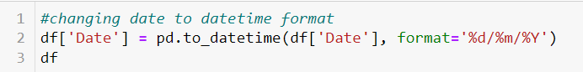
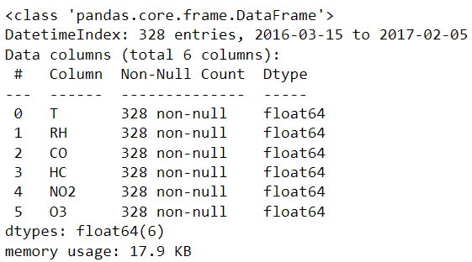
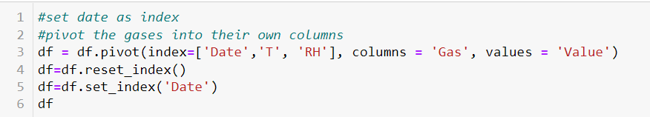
Data Processing
From here we can see that there are 4 types of gas for each day. On the same day, different gases can have different values of pollution but they all have same T and RH values.

Slide 6
Testing for Stationary
All the data are stationary based on the ADF test

Slide 7
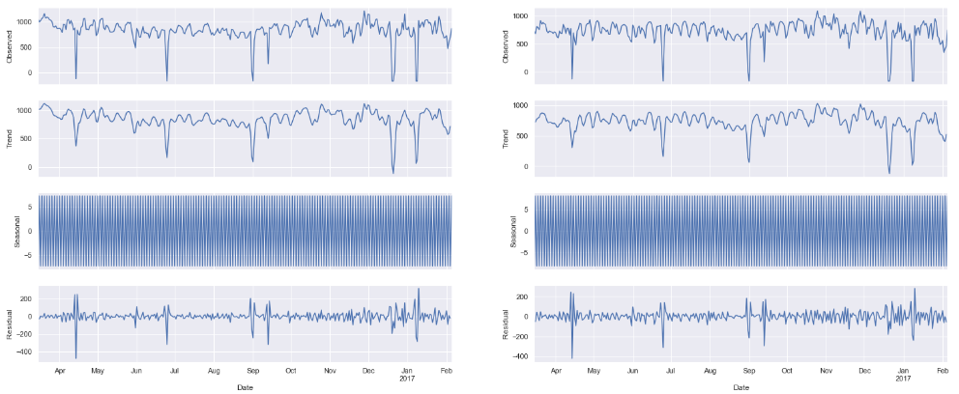
Checking Trends & Seasonal
All Gases have seasonal patterns, no obvious increasing or decreasing trend

Slide 8
Modelling in Progress ACF
ACF suggest AR(2) or AR(3)

Slide 9
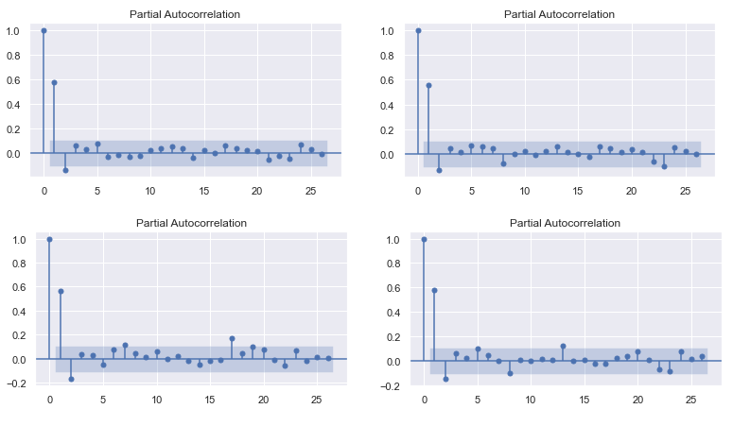
Modelling in Progress PACF
PACF suggest MA(2)

Slide 10
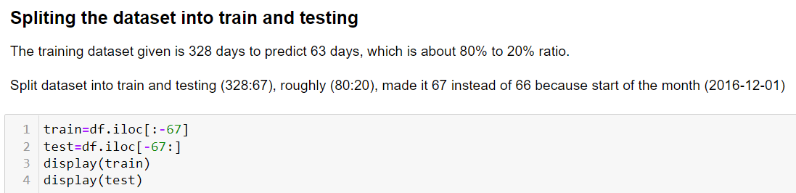
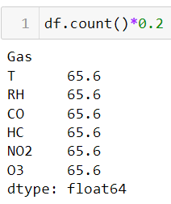
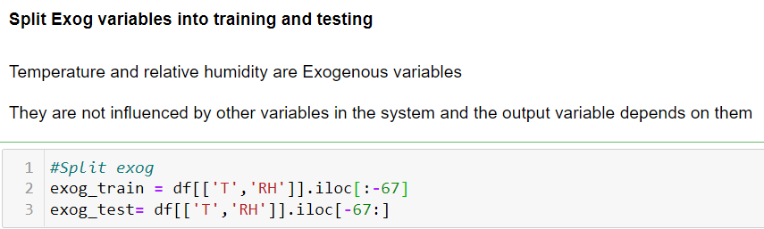

Slide 11
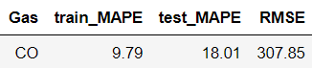
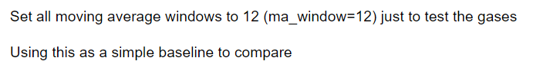
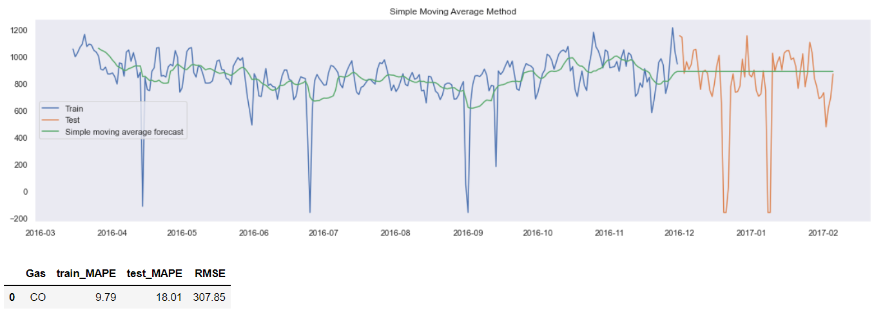
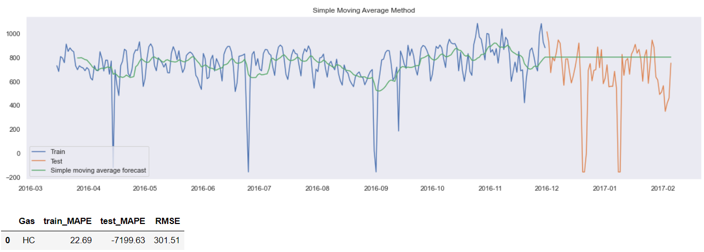
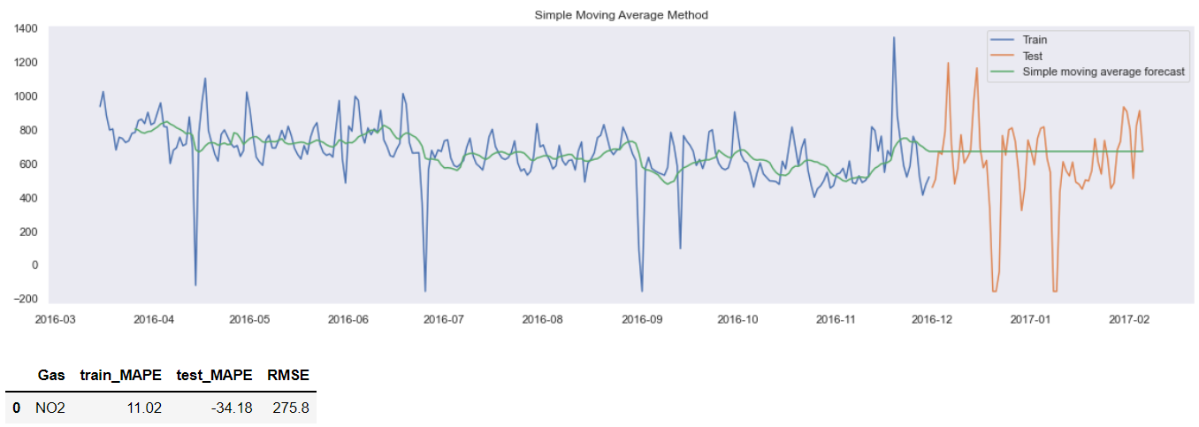
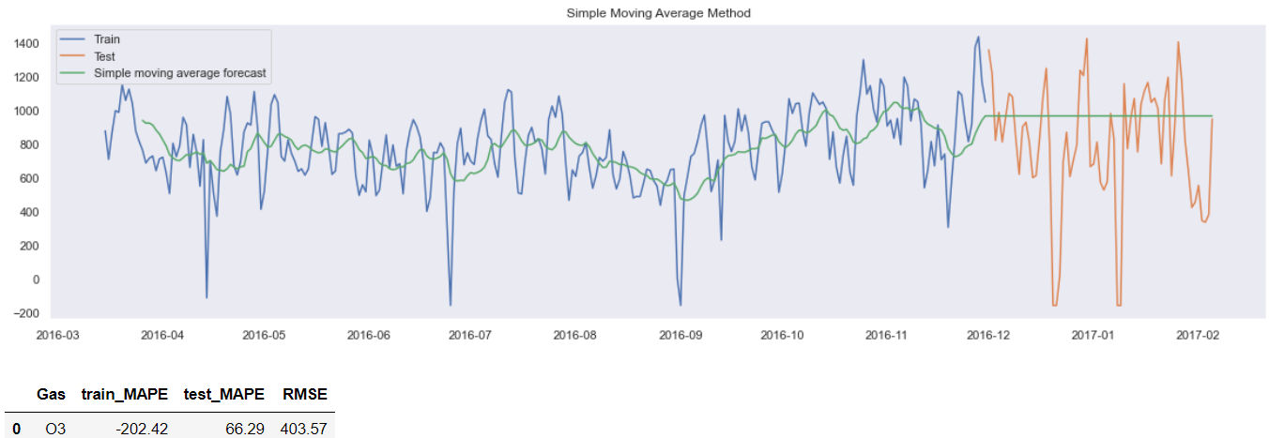
Model: Moving Average

Slide 12
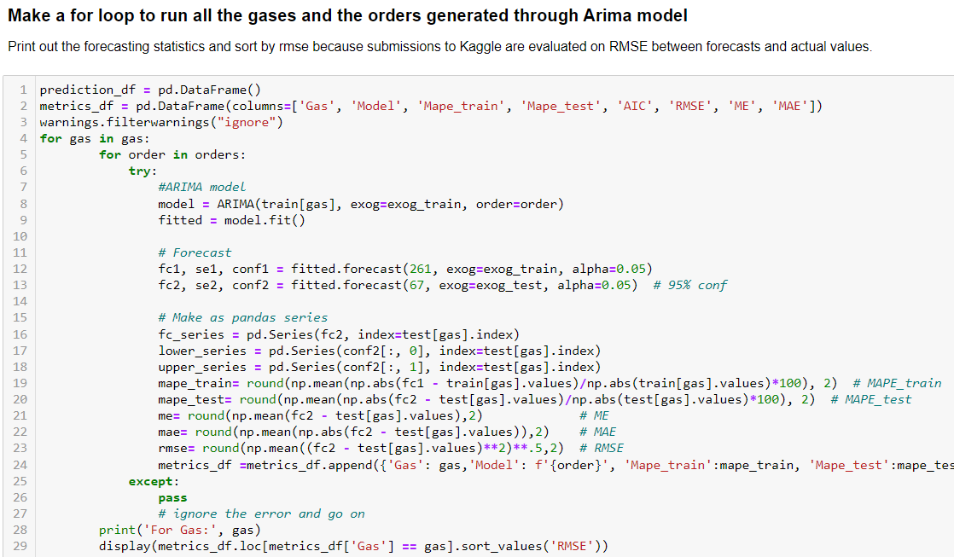
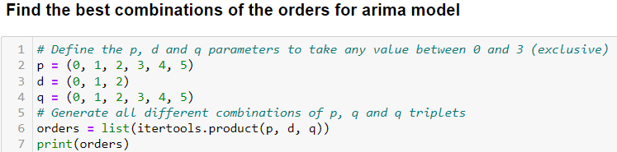
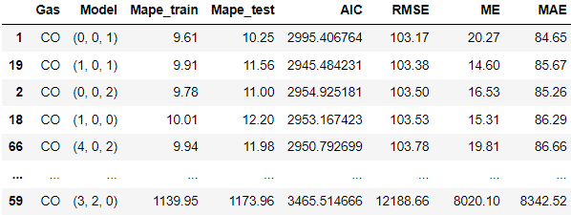
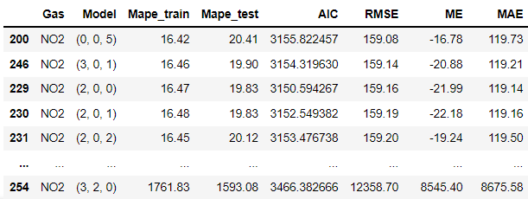
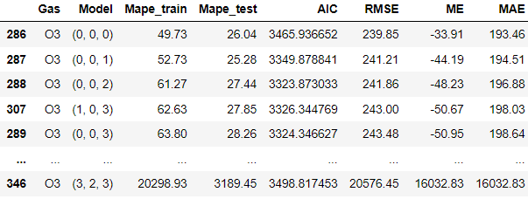
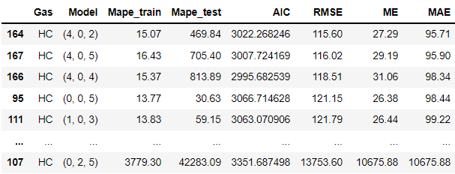
Model: Arima

Slide 13
Model Fitting ARIMA(0, 0, 1) for gas CO

Slide 14
Model Fitting ARIMA(4, 0, 2) for gas HC

Slide 15
Model Fitting ARIMA(0, 0, 5) for gas NO2

Slide 16
Model Fitting ARIMA(0, 0, 0) for gas O3

Slide 17
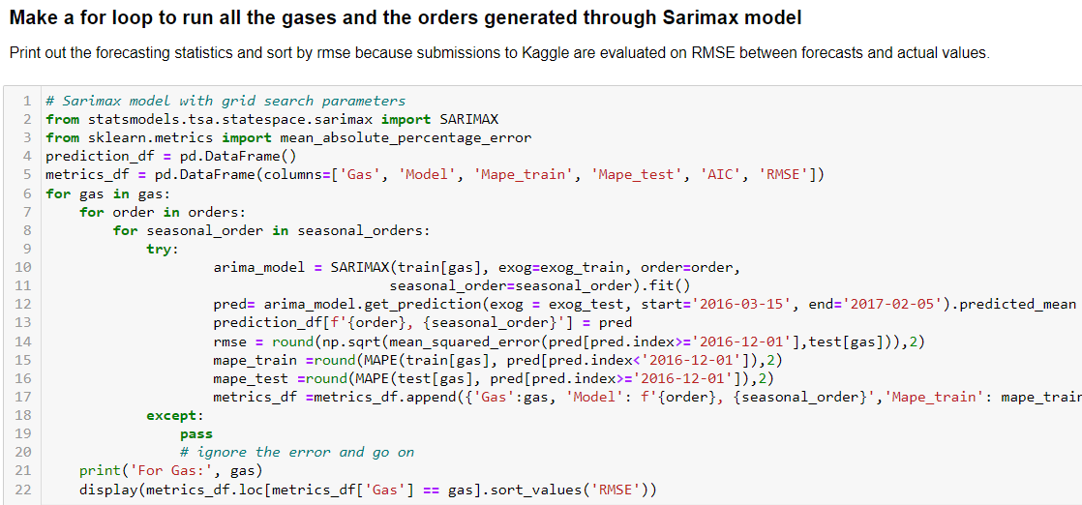
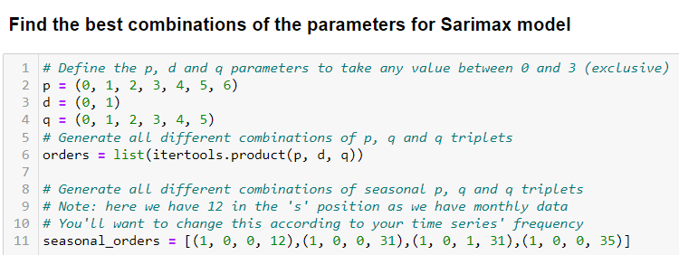
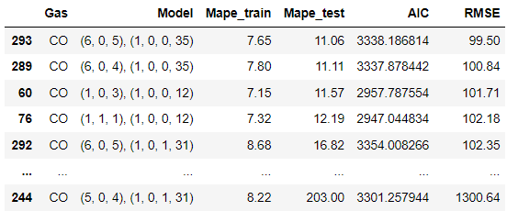
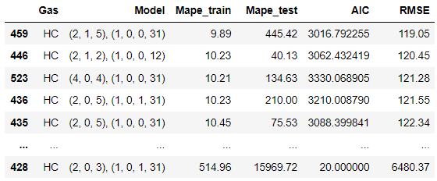
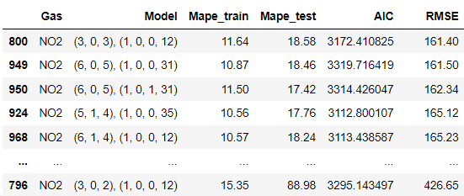
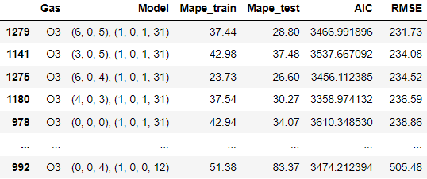
Model: Sarimax

Slide 18
Model Fitting SARIMAX for gas CO

Slide 19
Model Fitting SARIMAX for gas HC

Slide 20
Model Fitting SARIMAX for gas NO2

Slide 21
Model Fitting SARIMAX for gas O3

Slide 22
Diagnostics for model fitting
The residual errors seem to fluctuate around a mean of zero and have a uniform variance.
The residual errors seem to fluctuate around a mean of zero and have a uniform variance.
All the dots should fall perfectly in line with the red line. Any significant deviations would imply the distribution is skewed.
The ACF plot shows the residual errors are not autocorrelated.
No obvious pattern in the residual errors.

Slide 23
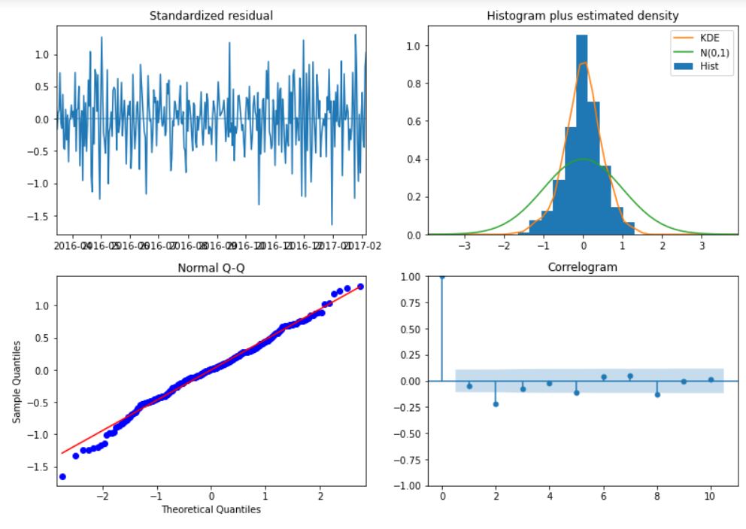
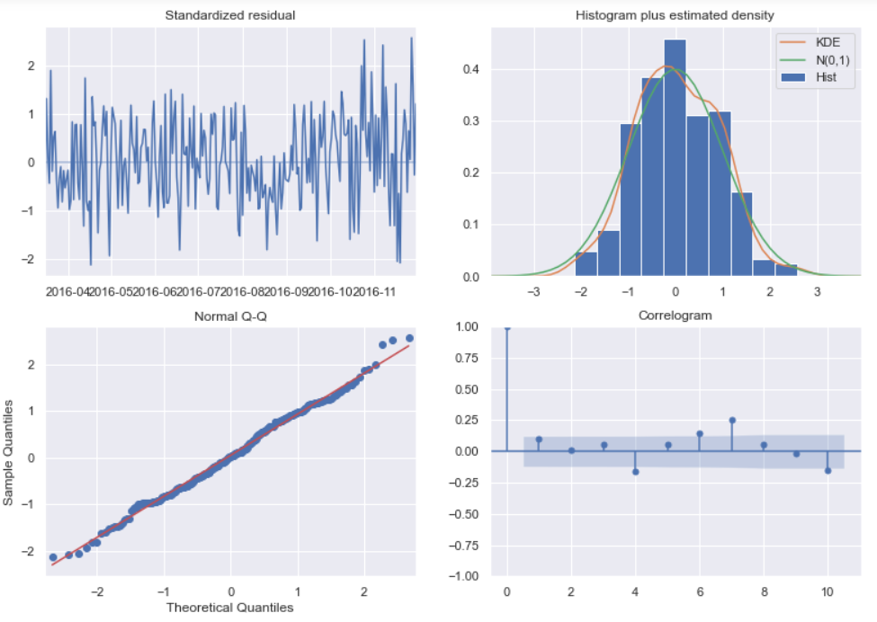
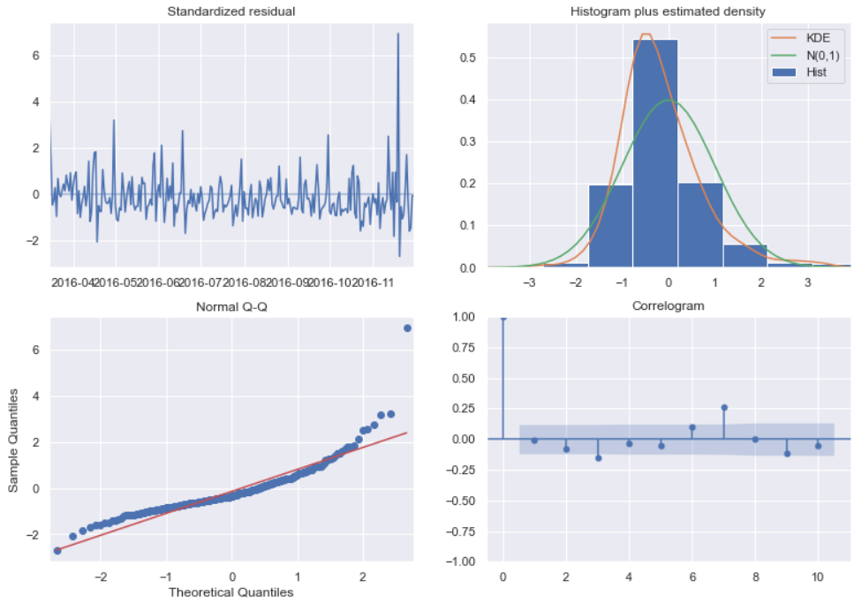
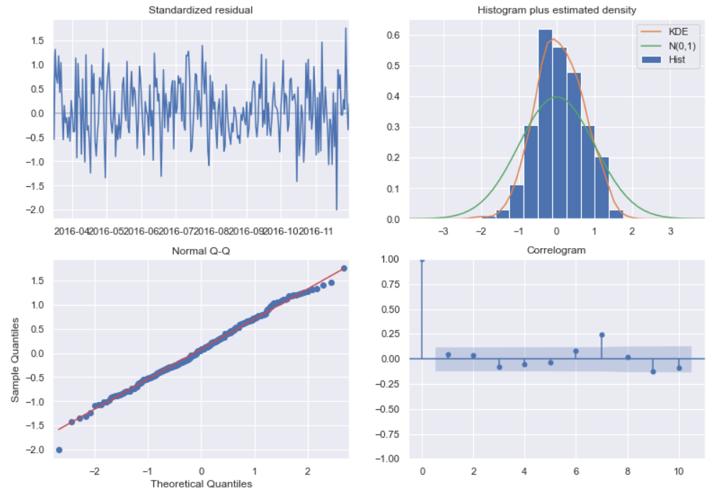
Diagnostics for model fitting

Slide 24
Find best Arima & Sarimax models
GAS | Model | MAPE_TRAIN | MAPE_TEST | RMSE
CO | ARIMA(0,0,1) SARIMAX(6,0,5)(1,0,0,35) | 9.61 7.65* | 10.25* 11.06 | 103.17 99.50*
HC | ARIMA(4,0,2) SARIMAX(2,1,5)(1,0,0,31) | 15.07 9.89* | 469.84 445.42* | 115.60* 119.05
NO2 | ARIMA(0,0,5) SARIMAX(3,0,3)(1,0,0,12) | 16.42 11.64* | 20.41 18.58* | 159.08* 161.40
O3 | ARIMA(0,0,0) SARIMAX(6,0,5)(1,0,1,31) | 49.73 37.44* | 26.04* 28.80 | 239.85 231.73*
Overall, SARIMAX model seems to be a better model in forecasting the Air Pollution Gases in Singapore.

Slide 25
Out-of-Sample Prediction gas CO

Slide 26
Out-of-Sample Prediction gas HC

Slide 27
Out-of-Sample Prediction gas NO2

Slide 28
Out-of-Sample Prediction gas O3

Slide 29
Conclusion
SARIMAX model can deal with external effects. This feature of the model differs from other models.
For example, with the air pollution data, the temperature, T and Humidity, H has seasonal effects too. We can’t predict the exact value for these factors if they do not appear in a cyclic or any seasonal behaviour.

